Slide 1
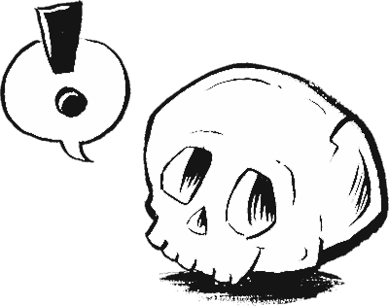

BE

Slide 2
CONTENTS
Preview
1-1 Singular Pronouns + Be
1-2 Plural Pronouns + Be
1-3 Singular Nouns + Be
1-4 Plural Nouns + Be
1-5 Contractions with Be
1-6 Negative with Be
1-7 Be + Adjective
1-8 Be + a Place
1-9 Summary: Basic Sentence Patterns with Be

Slide 3
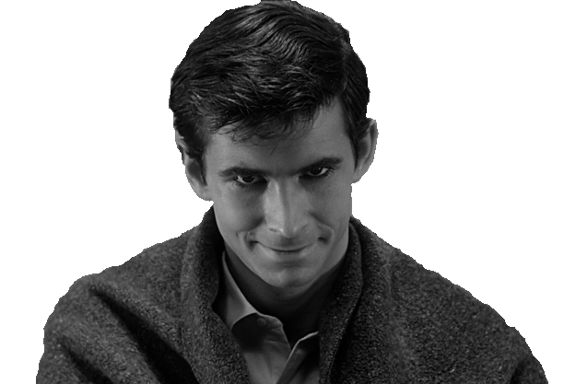
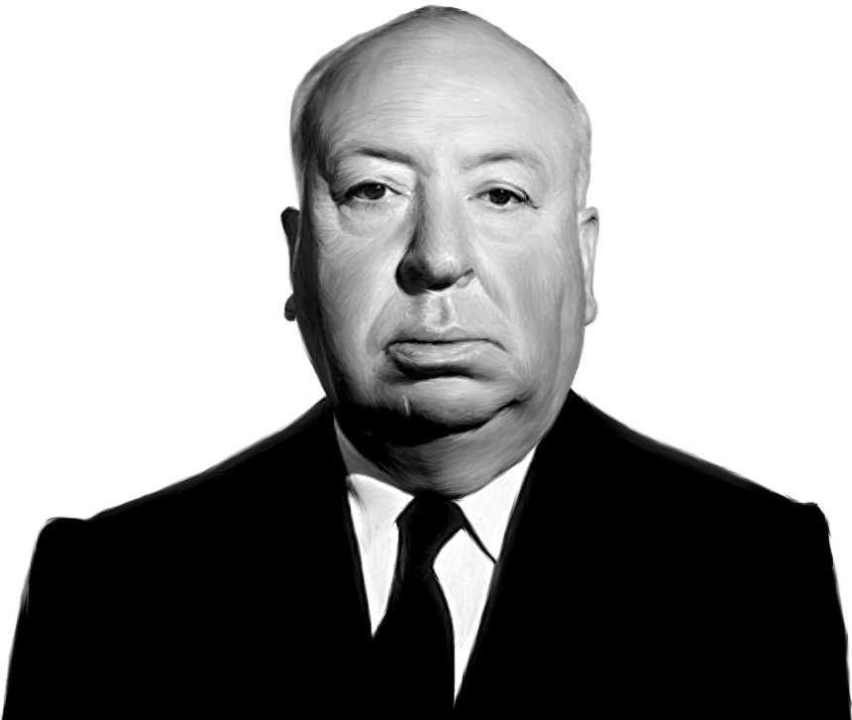
CHAPTER 1: PREVIEW
What’s your name?
My name is Norman.
First Name | Country
Norman

Slide 4
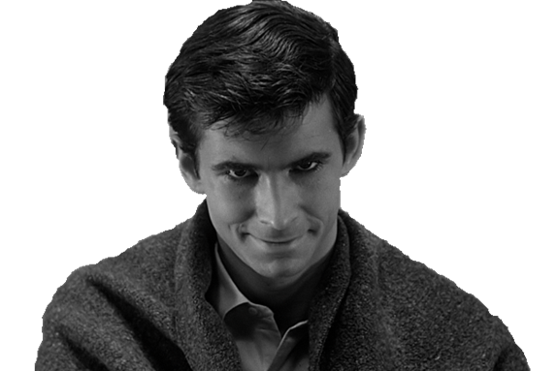

CHAPTER 1: PREVIEW
What country are you from?
I’m from USA.
First Name | Country
Norman
USA

Slide 5
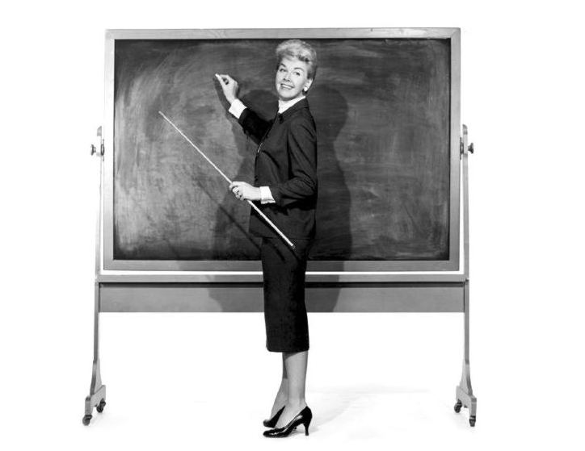
1-1 SINGULAR PRONOUNS + BE
1-2 PLURAL PRONOUNS + BE
I am a teacher.

Slide 6
1-1 SINGULAR PRONOUNS + BE
1-2 PLURAL PRONOUNS + BE
SINGULAR
(a) I am a teacher.
PRONOUN + BE + NOUN

Slide 7
1-1 SINGULAR PRONOUNS + BE
1-2 PLURAL PRONOUNS + BE
SINGULAR
(a) I am a teacher.
(b) You are a teacher.
PRONOUN + BE + NOUN

Slide 8
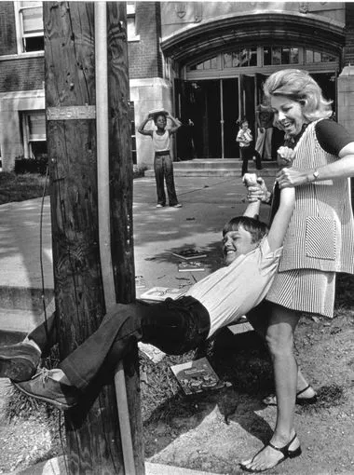
1-1 SINGULAR PRONOUNS + BE
1-2 PLURAL PRONOUNS + BE
SINGULAR
(a) I am a teacher.
(b) You are a teacher.
(c) She is a teacher.
PRONOUN + BE + NOUN

Slide 9
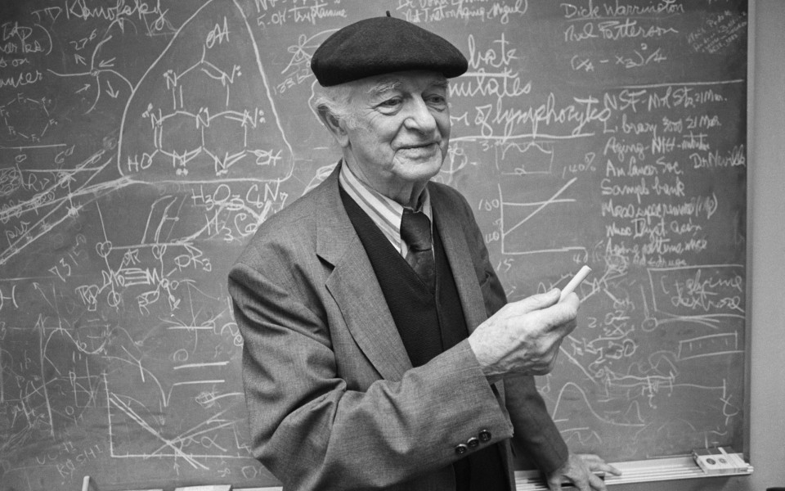
1-1 SINGULAR PRONOUNS + BE
1-2 PLURAL PRONOUNS + BE
PRONOUN + BE + NOUN
SINGULAR
(a) I am a teacher.
(b) You are a teacher.
(c) She is a teacher.
(d) He is a teacher.

Slide 10
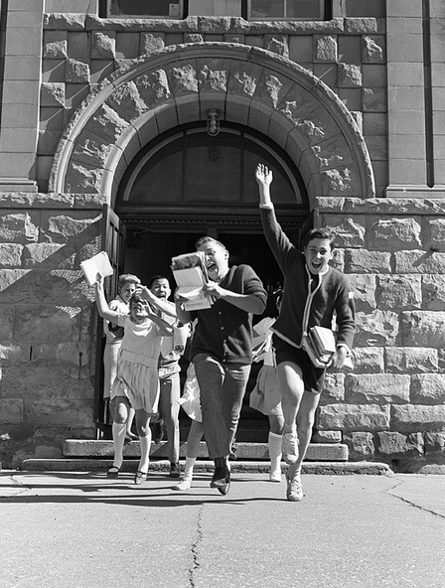
1-1 SINGULAR PRONOUNS + BE
1-2 PLURAL PRONOUNS + BE
SINGULAR
(a) I am a teacher.
(b) You are a teacher.
(c) She is a teacher.
(d) He is a teacher.
(e) It is a school.
PRONOUN + BE + NOUN

Slide 11
1-1 SINGULAR PRONOUNS + BE
1-2 PLURAL PRONOUNS + BE
SINGULAR
(a) I am a teacher.
(b) You are a teacher.
(c) She is a teacher.
(d) He is a teacher.
(e) It is a school.
PLURAL
PRONOUN + BE + NOUN
(f) We are teachers.
(g) You are teachers.
(h) They are teachers.

Slide 12
1-1 SINGULAR PRONOUNS + BE
1-2 PLURAL PRONOUNS + BE
SINGULAR
I am a teacher.
You are a teacher.
She is a teacher.
He is a teacher.
It is a school.
PLURAL
We are teachers.
You are teachers.
They are teachers.

Slide 13
1-1 SINGULAR PRONOUNS + BE
1-2 PLURAL PRONOUNS + BE
SINGULAR
I am a teacher.
You are a teacher.
She is a teacher.
He is a teacher.
It is a school.
PLURAL
We are teachers.
You are teachers.
They are teachers.

Slide 14
1-1 SINGULAR PRONOUNS + BE
1-2 PLURAL PRONOUNS + BE
SINGULAR
I am a teacher.
You are a teacher.
She is a teacher.
He is a teacher.
It is a school.
PLURAL
We are teachers.
You are teachers.
They are teachers.

Slide 15
1-1, 1-2, Let’s Practice
SINGULAR
I .
You ________ .
She _______ .
PLURAL
am a girl
We _______ .
You _______ .
They _______ .
are girls
are a girl
are girls
is a girl
are girls

Slide 16
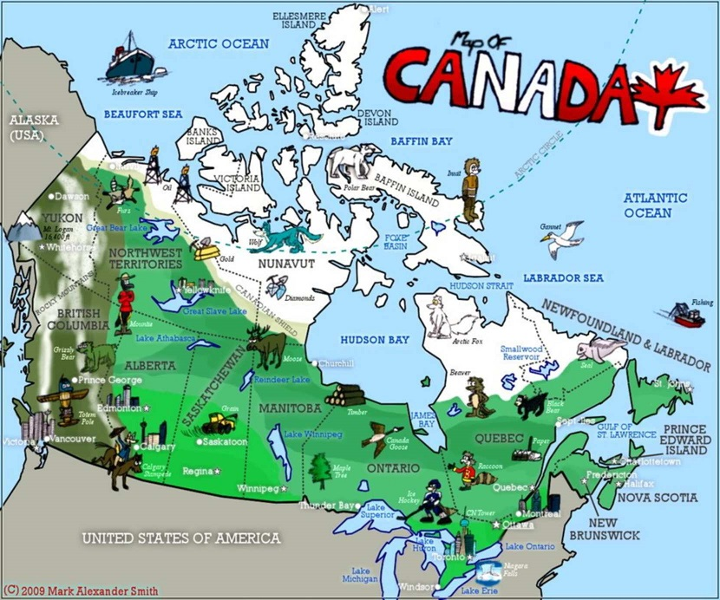
1-3 SINGULAR NOUNS + BE
Canada is a country.

Slide 17
1-3 SINGULAR NOUNS + BE
NOUN + IS + NOUN
(a) Canada is a country.
(a) Canada is a country.
Canada = a singular noun
is = a singular verb
country = a singular noun

Slide 18
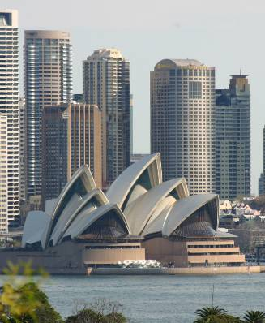
1-3 SINGULAR NOUNS + BE
(b) Sydney is a city.
(b) Sydney is a city.
A is an article.
A singular nouns

Slide 19
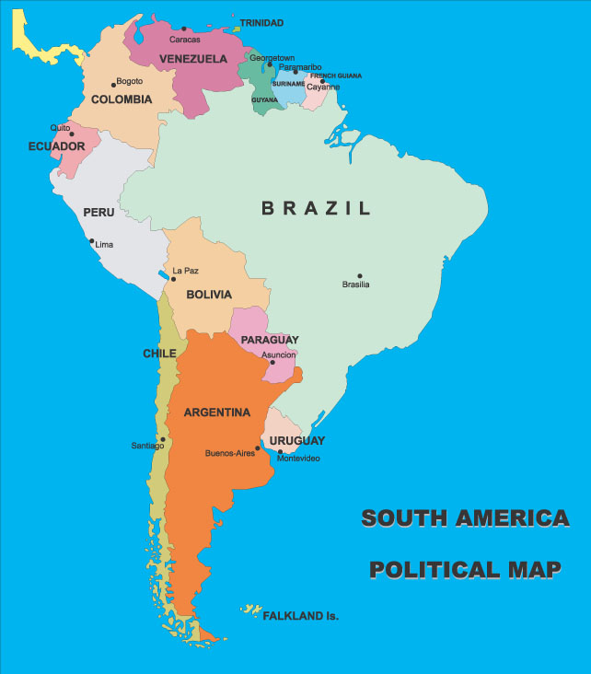
1-3 SINGULAR NOUNS + BE
Brazil is a country.
Peru is a country.
Santiago is a city.
*

Slide 20
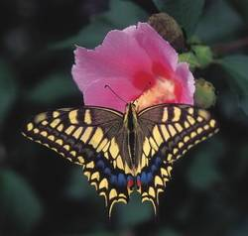
1-3 SINGULAR NOUNS + BE
(c) A butterfly is an insect.
A
An
same meaning
a and an are articles

Slide 21
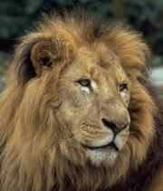
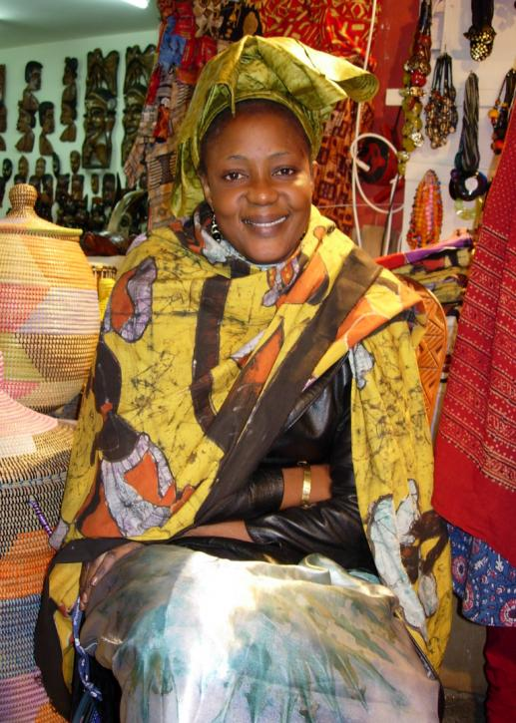
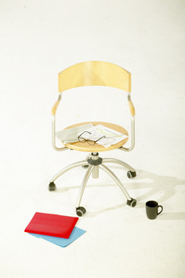
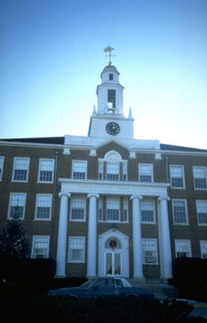
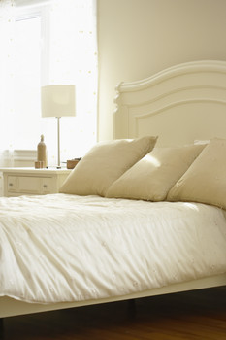
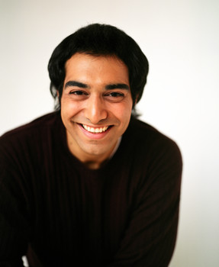
1-3 SINGULAR NOUNS + BE
a chair
a woman
a school
a lion
a bed
a man

Slide 22
1-3 SINGULAR NOUNS + BE
a chair
a woman
a school
A in front of
consonants
a lion
a bed
a man

Slide 23
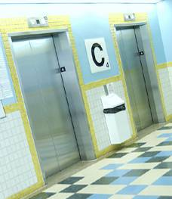
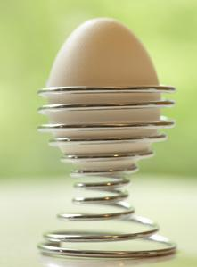
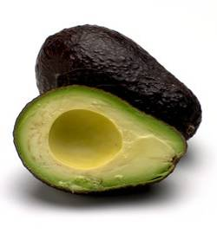
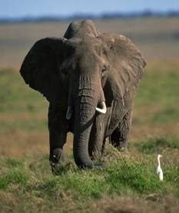
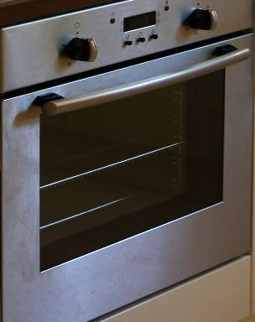
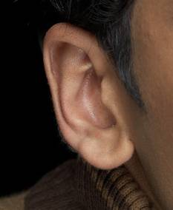
1-3 SINGULAR NOUNS + BE
an elevator
an egg
an avocado
an elephant
an oven
an ear

Slide 24
1-3 SINGULAR NOUNS + BE
an elevator
an egg
An in front of
vowels
an avocado
an elephant
an oven
an ear

Slide 25
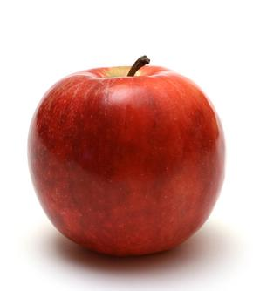

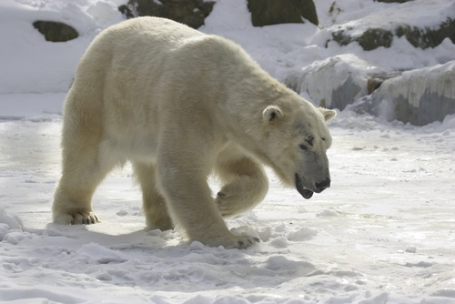
1-3 SINGULAR NOUNS + BE
An apple is a fruit.
A bear is an animal.
A rose is a flower.

Slide 26
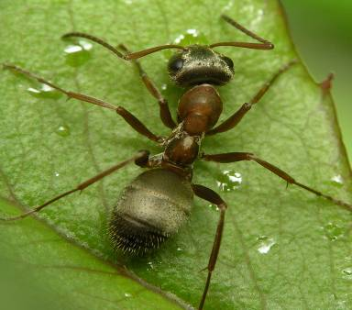
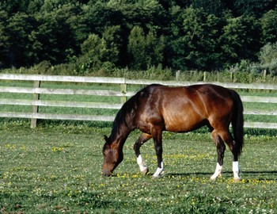
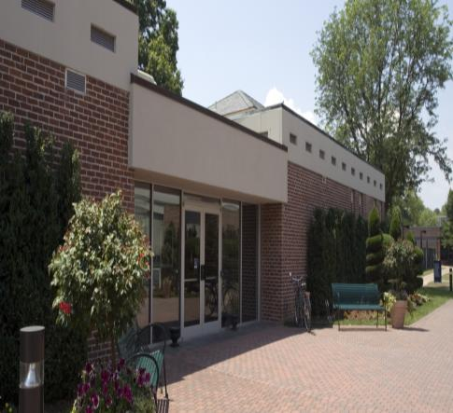

1-3 Let’s Practice
__ school is ___ building.
2. ___ horse is ___ animal.
3. ___ ant is ___ insect.
4. Soccer is ___ sport.
A
a
a an
A
an
An
an
a

Slide 27
1-3 Let’s Practice
Colombia is a ______.
Argentina is a ______.
Sao Paulo is a ___.
country
country
*
Sao Paulo
city

Slide 28
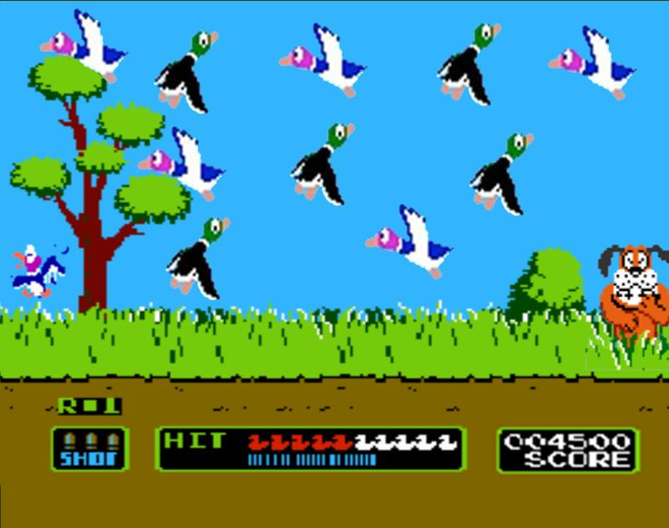
1-4 PLURAL NOUNS + BE
Ducks are birds.

Slide 29
1-4 PLURAL NOUNS + BE
NOUN + ARE + NOUN
(a) Ducks are birds.
(a) Ducks are birds.
Ducks = a plural noun
are = a plural verb
birds = a plural noun

Slide 30
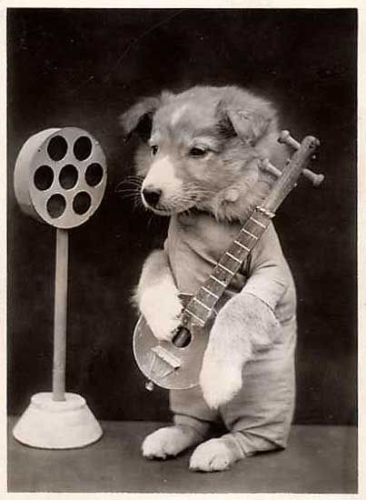
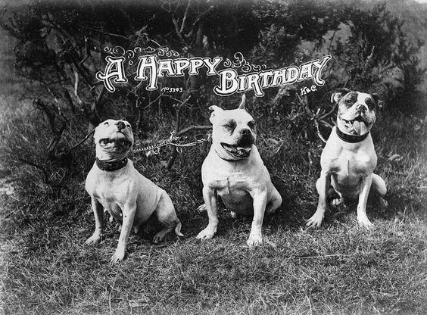
1-4 PLURAL NOUNS + BE
(b) SINGULAR: a dog, an animal
PLURAL: dogs, animals
a and an – only with singular nouns
plural nouns end in -s

Slide 31
1-4 PLURAL NOUNS + BE
(c) SINGULAR: a city, a country
PLURAL:
cities, countries
Omit the -y and add -ies
cit
ies
y

Slide 32
1-4 PLURAL NOUNS + BE
(c) SINGULAR: a city, a country
PLURAL:
cities, countries
Omit the -y and add -ies
countr
ies
y

Slide 33
1-4 PLURAL NOUNS + BE
NOUN and NOUN + ARE + NOUN
(d) Italy and Greece are countries.
(e) Bees and ants are bugs.

Slide 34
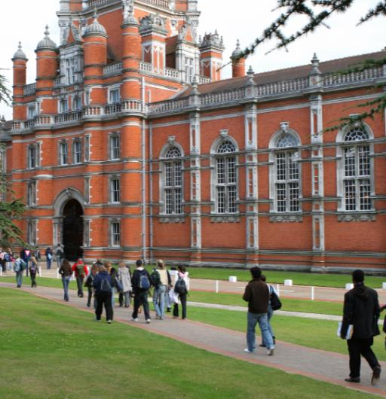
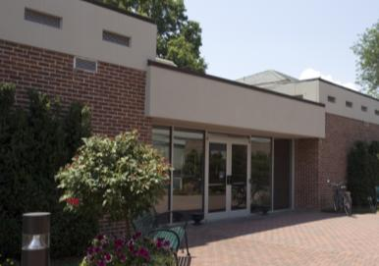

1-4 PLURAL NOUNS + BE
plural
Schools are buildings.
singular
A school is a building.

Slide 35
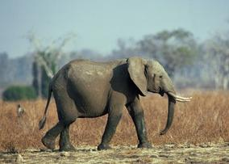
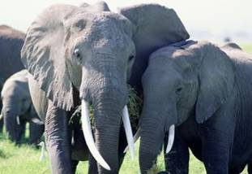
1-4 Let’s Practice
singular
An elephant is
an animal.
plural
Elephants are
animals.

Slide 36
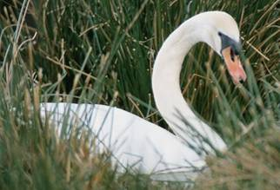
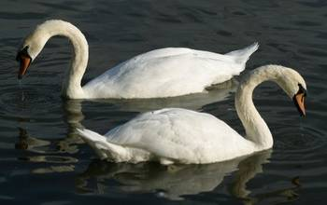
1-4 Let’s Practice
singular
A swan is a bird.
plural
Swans are birds.

Slide 37
1-5 CONTRACTIONS WITH BE
I’m a teacher.

Slide 38
1-5 CONTRACTIONS WITH BE
PRONOUN + BE
CONTRACTION
AM
I + am I’m
I’m a teacher.

Slide 39
1-5 CONTRACTIONS WITH BE
PRONOUN + BE
CONTRACTION
she + is she’s
IS
he + is he’s
it + is it’s
He’s a boy.
She’s a girl.
It’s a cat.

Slide 40
1-5 CONTRACTIONS WITH BE
PRONOUN + BE
CONTRACTION
you + are you’re
ARE
we + are we’re
they + are they’re
They’re students.
We’re students.
You’re students.

Slide 41
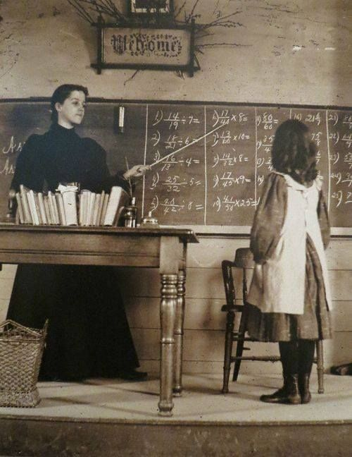
1-6 NEGATIVE WITH BE
I am not a teacher.

Slide 42
1-6 NEGATIVE WITH BE
CONTRACTIONS
She’s not
She isn’t
He’s not
He isn’t
I’m not
You’re not
You aren’t
(a) I am not a doctor.
(b) You are not a doctor.
(c) She is not a doctor.
(d) He is not a doctor.

Slide 43
1-6 NEGATIVE WITH BE
CONTRACTIONS
They’re not
They aren’t
You’re not
You aren’t
It’s not
It isn’t
We’re not
We aren’t
(e) It is not a city.
(f ) We are not doctors.
(g) You are not teachers.
(h) They are not teachers.

Slide 44
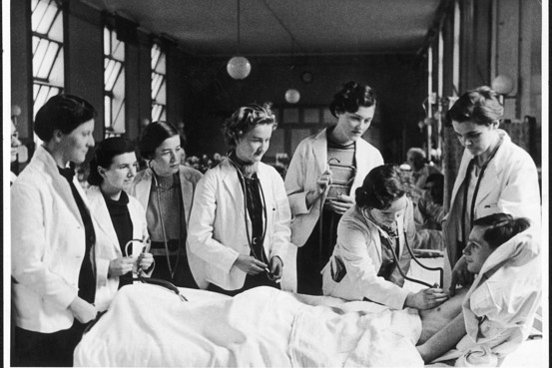
1-6 Let’s Practice
isn’t aren’t
The women ______ nurses.
aren’t
they doctors
They’re doctors
______________.

Slide 45
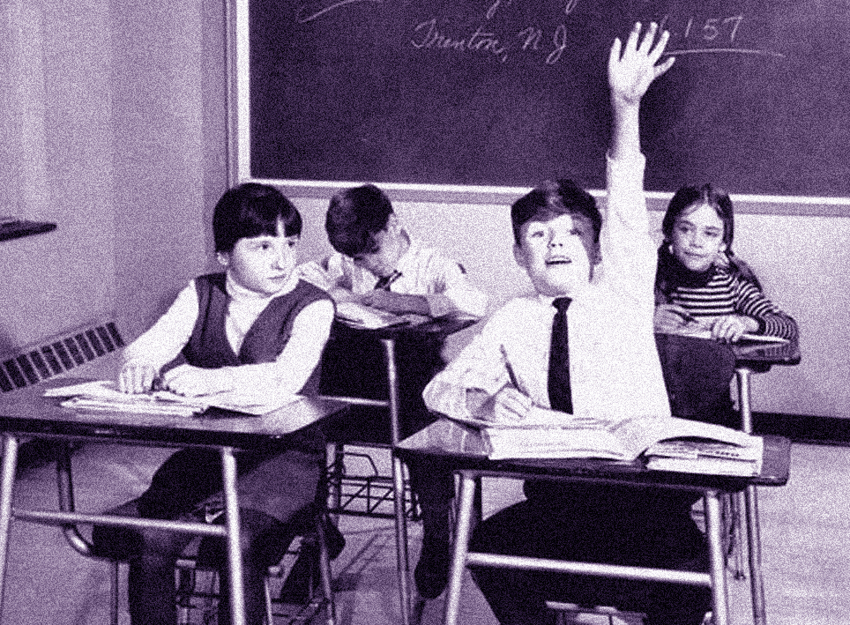
1-6 Let’s Practice
isn’t aren’t
This girl ____ a teacher.
isn’t
she student
She’s a student
______________.

Slide 46

1-6 Let’s Practice
isn’t aren’t
This animal _____ a dog.
isn’t
it cat
_________.
It’s a cat

Slide 47
That’s all
FOR NOW

