Slide 1


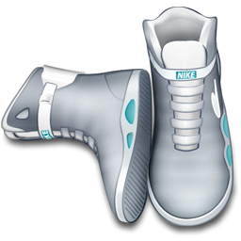
Expressing
Future Time

Slide 2
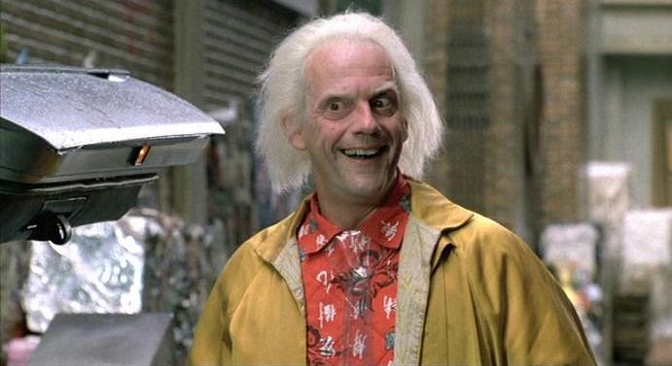
FUTURE TIME: USING BE GOING TO
I am going to go
downtown tomorrow.

Slide 3
FUTURE TIME: USING BE GOING TO
(a) I am going to go downtown tomorrow.
(b) Javier is going to be at school today.
(c) They are going to come home later.
be going to – expresses future
am
is
are
+ going + infinitive

Slide 4
FUTURE TIME: USING BE GOING TO
(d) I’m not going to go downtown tomorrow.
(e) Ann isn’t going to dance at the party.
NEGATIVE: be + not + going to

Slide 5
FUTURE TIME: USING BE GOING TO
(f) Are they going to go home at 6 PM?
No, they aren’t.
(g) Is Alex going to be at school tomorrow?
Yes, he is.
(h) What time are you going to play tennis?
Around noon.
QUESTION:
be + subject + going to

Slide 6
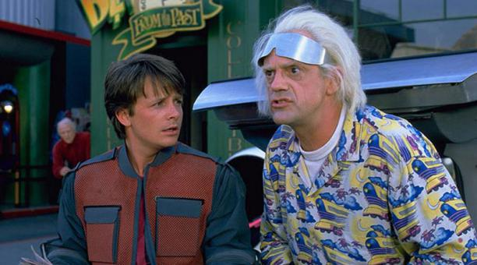
Let’s Practice
yes
go to work
Are you going to go to work
on Monday?
Yes, I am
I’m going to go to work on Monday
__________. ___________________________.

Slide 7
Let’s Practice
No, I’m not
I’m not going to watch the news on TV
no
watch the news
__________. _________________________________.
Are you going to
watch the news on TV?

Slide 8
Let’s Practice
yes
study English
Yes, I am
I’m going to study English this year
__________. ___________________________.
Are you going to
study English
this year?

Slide 9

USING THE PRESENT CONTINUOUS TO EXPRESS FUTURE TIME
Zoila is leaving at noon tomorrow.

Slide 10
USING THE PRESENT CONTINUOUS TO EXPRESS FUTURE TIME
(a) Zoila is going to leave at noon tomorrow.
(b) Zoila is leaving at noon tomorrow.
same meaning

Slide 11
USING THE PRESENT CONTINUOUS TO EXPRESS FUTURE TIME
(c) They are going to fly to Tokyo tomorrow.
(d) They are flying to Tokyo tomorrow.
same meaning

Slide 12
USING THE PRESENT CONTINUOUS TO EXPRESS FUTURE TIME
Common Verbs
come
do
drive
fly
go
leave
meet
return
spend
start
stay
take

Slide 13
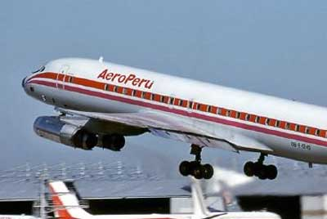
Let’s Practice
They are going to fly
to Peru on Monday.
They are
flying to
Peru on Monday
.
present continuous

Slide 14
Let’s Practice
They are going to leave at 9:00 tomorrow.
They are leaving at 9:00 tomorrow
.
present continuous

Slide 15
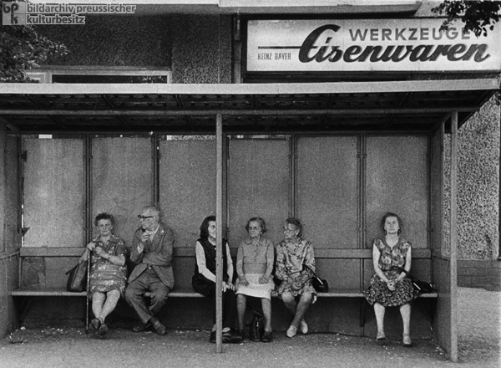
Let’s Practice
I am going to meet her at the bus stop.
I am meeting her at the bus stop
.
present continuous

Slide 16
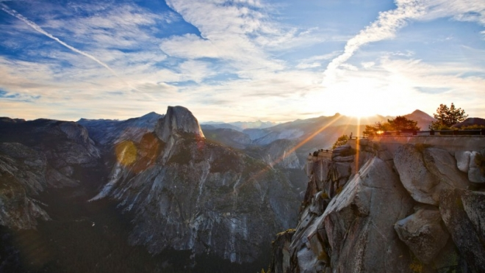
WORDS USED FOR PAST TIME AND FUTURE TIME
It’s going to be a
nice day tomorrow.

Slide 17
WORDS USED FOR PAST TIME AND FUTURE TIME
PAST
FUTURE
yesterday tomorrow
It snowed
yesterday.
It’s going to snow
tomorrow.

Slide 18
WORDS USED FOR PAST TIME AND FUTURE TIME
PAST
FUTURE
yesterday morning tomorrow morning
yesterday evening tomorrow evening
last night tomorrow night
I went to class
last night.
I’m going to go
to class tomorrow
night.

Slide 19
WORDS USED FOR PAST TIME AND FUTURE TIME
PAST
FUTURE
last week next week
He went to the
doctor last week.
He’s going to
go to the doctor
next week.

Slide 20
WORDS USED FOR PAST TIME AND FUTURE TIME
PAST
FUTURE
month month
year year
weekend weekend
spring spring
last
next
She went home
last spring.
She’s going to go home next spring.

Slide 21
WORDS USED FOR PAST TIME AND FUTURE TIME
PAST
FUTURE
... minutes ago in ... minutes (from now)
... days ago in ... days (from now)
... weeks ago in ... weeks (from now)
... months ago in ... months (from now)
... years ago in ... years (from now)
I washed some
of the dishes ten
minutes ago.
Jay is going to wash the rest in five minutes.

Slide 22
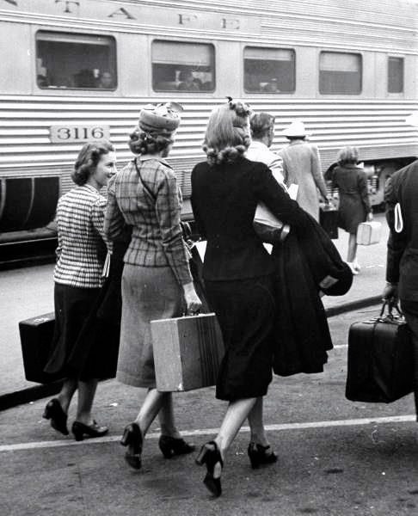
FUTURE TIME: USING WILL
They will arrive at
10:00 tomorrow.

Slide 23
FUTURE TIME: USING WILL
STATEMENT
(a) They will arrive at 10:00 tomorrow.
(b) They are going to arrive at 10:00
tomorrow.
same meaning
(basically)

Slide 24
FUTURE TIME: USING WILL
STATEMENT
(c) CORRECT: Jane will see a movie.
INCORRECT:
?
Jane will sees a movie.
INCORRECT:
?
Jane wills see a movie.

Slide 25
FUTURE TIME: USING WILL
STATEMENT
(d) CORRECT: Jane will come today.
INCORRECT:
?
Jane will comes today.

Slide 26
FUTURE TIME: USING WILL
STATEMENT
(e) CORRECT: Jane will eat breakfast.
?
INCORRECT:
Jane will to eat breakfast.

Slide 27
FUTURE TIME: USING WILL
CONTRACTIONS
(f) I will sing.
You will sing.
She will sing.
He will sing.
It will sing.
We will sing.
They will sing.
= I’ll sing.
= You’ll sing.
= She’ll sing.
= He’ll sing.
= It’ll sing.
= We’ll sing.
= They’ll sing.
Will is contracted to ’ll.

Slide 28
FUTURE TIME: USING WILL
STATEMENT
(g) Amy will not be at work tomorrow.
(h) Amy won’t be at work tomorrow.
won’t
will
+
not

Slide 29
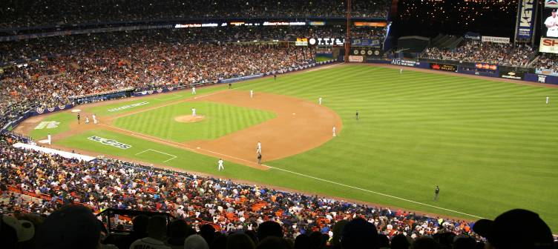
10-6 Let’s Practice
We aren’t going to watch the game tonight.
will
We ______watch the game tonight.
won’t
(contraction)

Slide 30
10-6 Let’s Practice
Mr. Brown is sick. He is going to go to the doctor this afternoon.
will
He___ go to the doctor this afternoon.
’ll
(contraction)

Slide 31
10-6 Let’s Practice
They are going to have a picnic tomorrow.
will
They’ll have a picnic tomorrow.
(contraction)

Slide 32
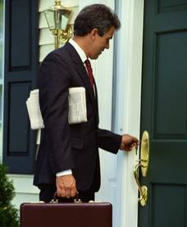
ASKING QUESTIONS WITH WILL
  Will Tom come home tomorrow?

Slide 33
ASKING QUESTIONS WITH WILL
QUESTION
MAIN
WILL + SUBJECT + VERB
(a) Will Rita go tomorrow?
ANSWER
Yes, she will.
No, she won’t.

Slide 34
ASKING QUESTIONS WITH WILL
QUESTION
MAIN
WILL + SUBJECT + VERB
(b) Will they go home later ?
ANSWER
Yes, they will.
No, they won’t.

Slide 35
ASKING QUESTIONS WITH WILL
QUESTION
(QUESTION MAIN
WORD) + WILL + SUBJECT + VERB
(c) When will they be in London?
ANSWER
Next weekend.

Slide 36
ASKING QUESTIONS WITH WILL
QUESTION
(QUESTION MAIN
WORD) + WILL + SUBJECT + VERB
(d) What time will we go out ?
ANSWER
7:30 P.M.

Slide 37
ASKING QUESTIONS WITH WILL
QUESTION
(QUESTION MAIN
WORD) + WILL + SUBJECT + VERB
(e) Where will she study English?
ANSWER
At college.

Slide 38
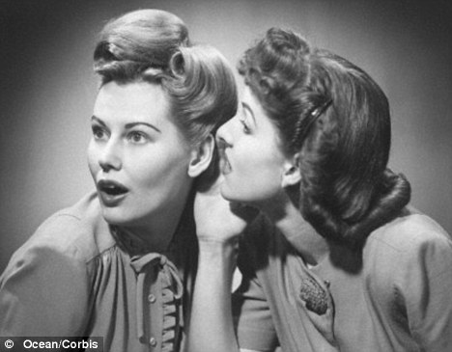
Let’s Practice
When will you graduate
______________________?
I will graduate
in June.

Slide 39
Let’s Practice
Where will you live after college
_____________________________?
I will live in
Buenos Aires
after college.

Slide 40
Let’s Practice
Will we go out for lunch
_____________________?
Yes, we will go
out for lunch.

Slide 41
Let’s Practice
What time will we go to lunch
__________________________?
We will go to
lunch at 1:30.

Slide 42
FUTURE
STATEMENT
NEGATIVE
QUESTION
I am going
to eat pizza
for lunch.
She is going
to eat soup
for lunch.
I’m not
going to eat
pizza for
breakfast.
They aren’t
going to
eat pizza.
Are you
going to
eat pizza for
lunch?
Is he going
to eat soup?
BE GOING TO

Slide 43
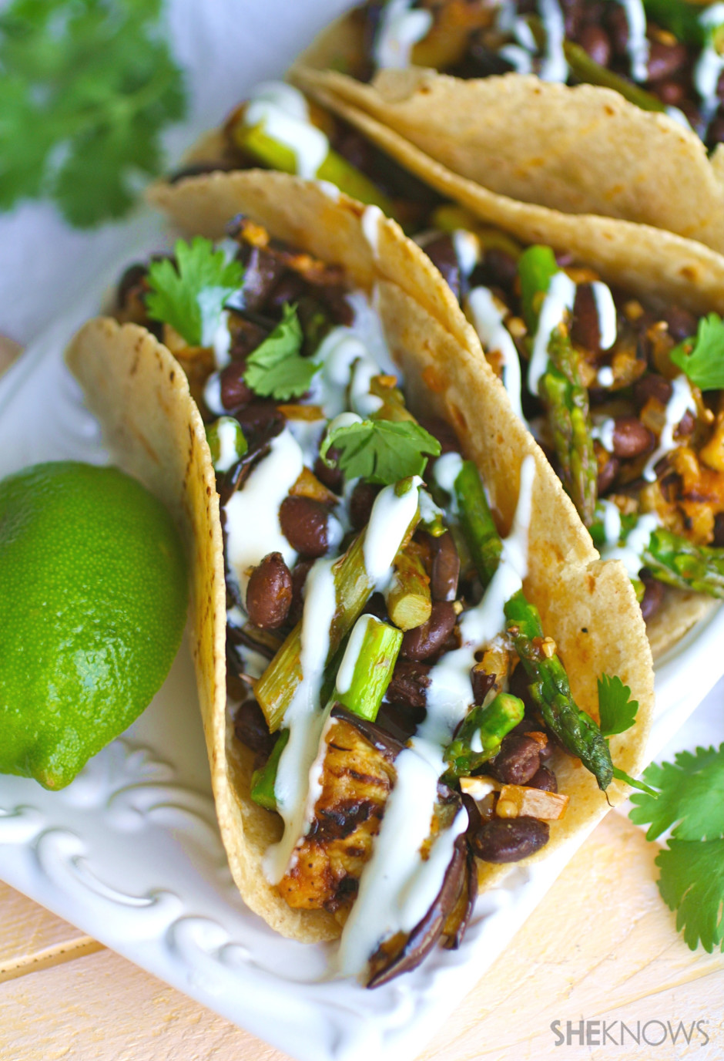
FUTURE
STATEMENT
NEGATIVE
QUESTION
They will
eat tacos
for dinner.
She won’t
eat tacos
for dinner.
Will he eat
tacos for
dinner?
WILL

