Slide 1
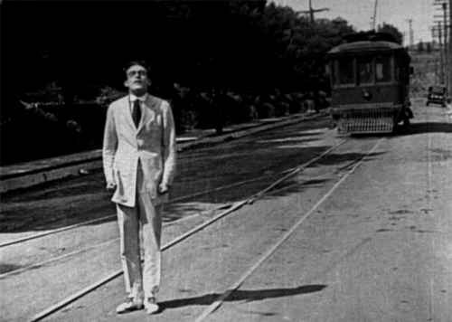
Present Continuous

Slide 2
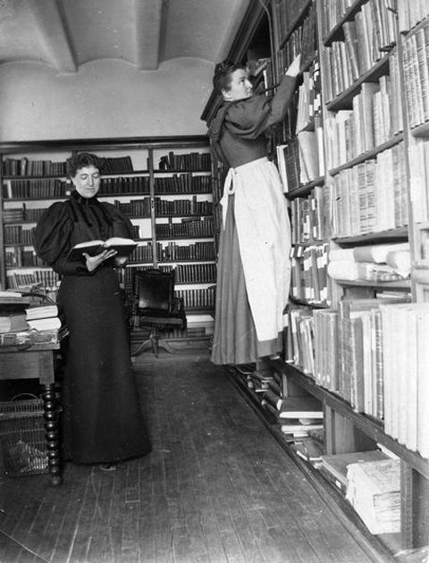
4-1 BE + -ING: THE PRESENT CONTINUOUS
I am working in the
library right now.

Slide 3
4-1 BE + -ING: THE PRESENT CONTINUOUS
am + -ing
(a) I am working in the library right now.
is + -ing
(b) Lily is working in the library right now.
are + -ing
(c) You are working in the library right now.
Action is
right now.
am, is, are + -ing
present continuous tense

Slide 4
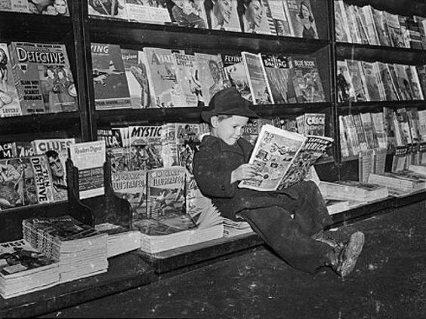
4-1 Let’s Practice
read
What is the boy doing?
is reading
He _________.

Slide 5
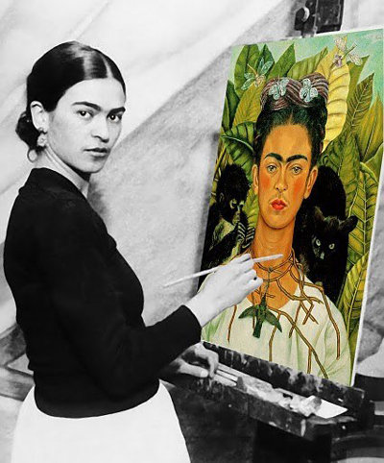
4-1 Let’s Practice
paint
What is the girl doing?
She _________.
is painting

Slide 6
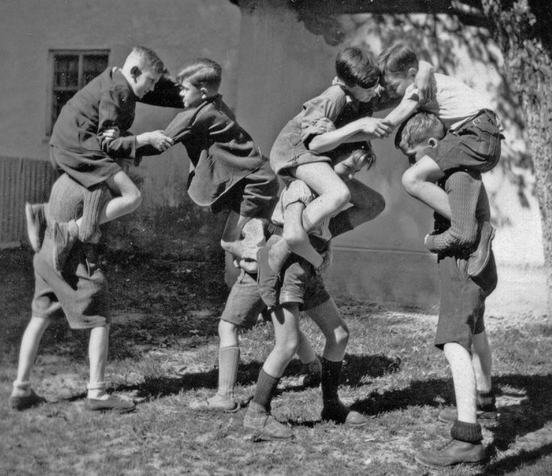
4-1 Let’s Practice
play
What are the children doing?
They _________.
are playing

Slide 7
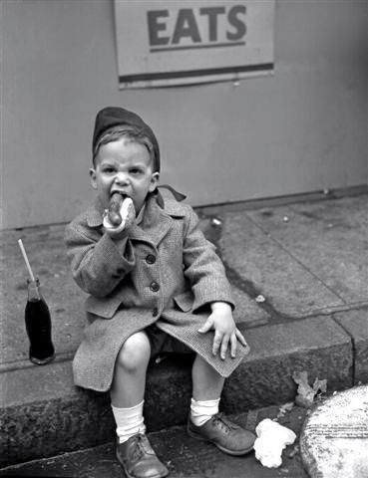
4-1 Let’s Practice
eat
What is the boy doing?
He _______.
is eating

Slide 8
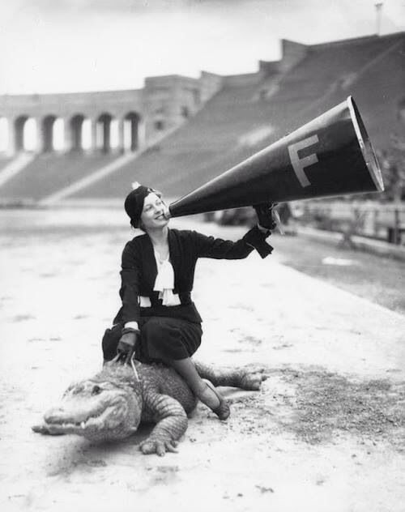
4-2 SPELLING OF -ING
She is sitting.

Slide 9
4-2 SPELLING OF -ING
END OF VERB -ING FORM
*
Rule
1
A CONSONANT + -e
DROP THE -e and ADD -ing
smil
ing
e
example:
*
b,c,d,f,g,h,j,k,l,m,n,p,q,r,s,t,v,w,x,y,z

Slide 10
4-2 SPELLING OF -ING
example
END OF VERB -ING FORM
Rule
1
A CONSONANT + -e
DROP THE -e and ADD -ing
din
ing
e
example:

Slide 11
4-2 SPELLING OF -ING
END OF VERB -ING FORM
*
Rule
2
ONE VOWEL + ONE CONSONANT
DOUBLE THE CONSONANT and ADD -ing
sit
t
ing
example:
*
a,e,i,o,u
exception: do not double w, x, and y

Slide 12
4-2 SPELLING OF -ING
END OF VERB -ING FORM
Rule
2
ONE VOWEL + ONE CONSONANT
DOUBLE THE CONSONANT and ADD -ing
plan
n
ing
ing
example:

Slide 13
4-2 SPELLING OF -ING
END OF VERB -ING FORM
Rule
3
TWO VOWELS + ONE CONSONANT
ADD -ing;
DO NOT DOUBLE THE CONSONANT
read
ing
example:

Slide 14
4-2 SPELLING OF -ING
END OF VERB -ING FORM
Rule
3
TWO VOWELS + ONE CONSONANT
ADD -ing;
DO NOT DOUBLE THE CONSONANT
sleep
ing
example:

Slide 15
4-2 SPELLING OF -ING
END OF VERB -ING FORM
Rule
4
TWO CONSONANTS
ADD -ing;
DON’T DOUBLE THE CONSONANT
brush
ing
example:

Slide 16
4-2 SPELLING OF -ING
END OF VERB -ING FORM
Rule
4
TWO CONSONANTS
ADD -ing;
DON’T DOUBLE THE CONSONANT
drink
ing
example:

Slide 17
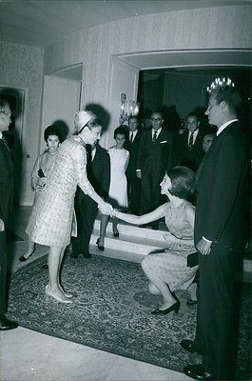
4-2 Let’s Practice
shake hands
What are the women doing?
The women _______________.
are shaking hands
Rule 1: Drop the -e and add -ing

Slide 18
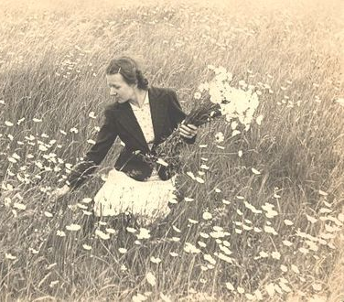
4-2 Let’s Practice
pick flowers
What is Marta doing?
Marta ______________.
is picking flowers
Rule 4: Add -ing; do not double the consonant

Slide 19
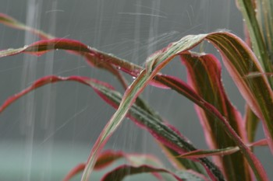
4-2 Let’s Practice
rain
What is it doing?
It is raining
_________.
Rule 3: Add -ing; do not double the consonant

Slide 20
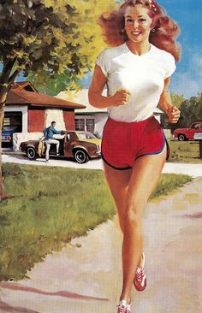
4-2 Let’s Practice
run
What is the girl doing?
The girl __________.
is running
Rule 2: Double the consonant and add -ing

Slide 21
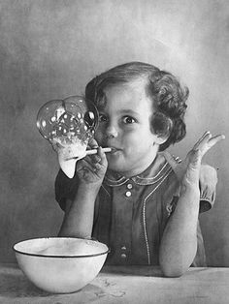
4-2 Let’s Practice
blow bubbles
What is the girl doing?
She _______________.
is blowing bubbles
EXCEPTION to Rule 2: don’t double w

Slide 22
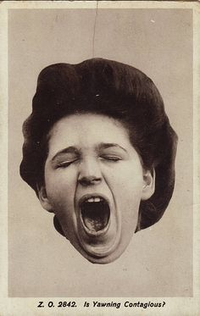
4-3 PRESENT CONTINUOUS: NEGATIVES
He is not studying.
He is yawning.

Slide 23
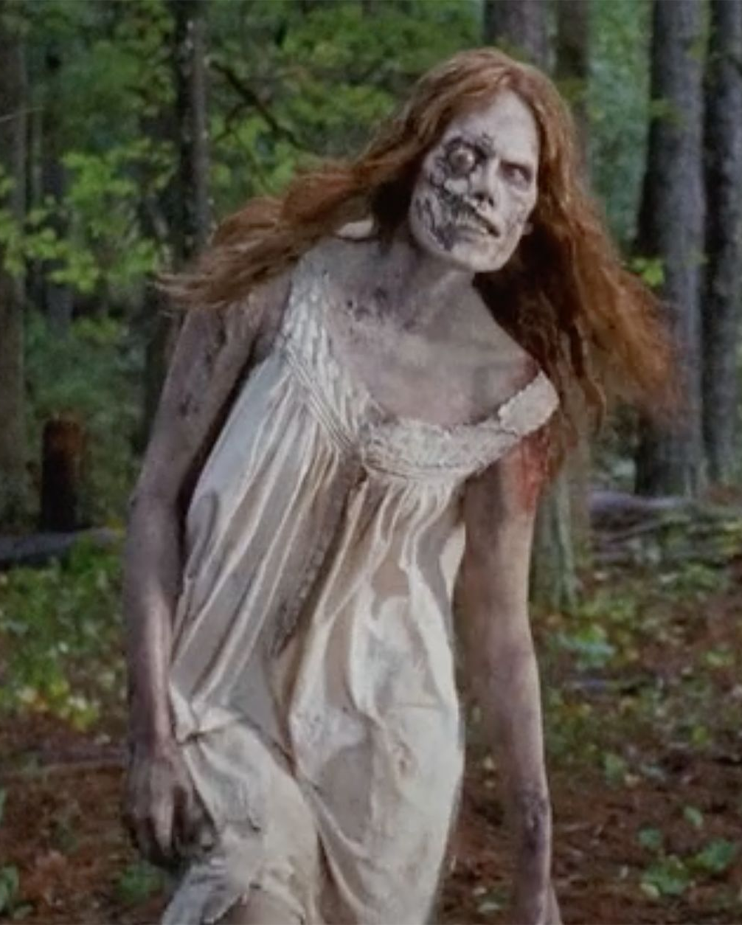
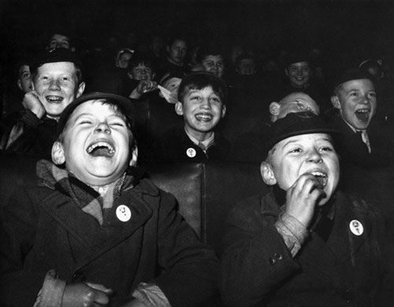
4-3 PRESENT CONTINUOUS: NEGATIVES
(a) I am not studying.
I am yawning.
(b) Jane isn’t running.
She’s walking.
(c) Scott and Mike aren’t crying.
They’re laughing.
Present continuous negative:
am
is
are
+ not + -ing

Slide 24
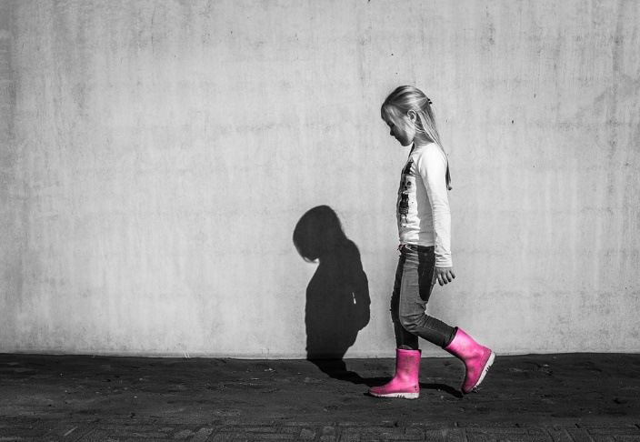
PRESENT CONTINUOUS: QUESTIONS
Is Ester walking?

Slide 25

PRESENT CONTINUOUS: QUESTIONS
SHORT ANSWER
LONG ANSWER
QUESTION
BE + SUBJECT + -ING
(a) Is Ester walking?
Yes, they are.
They are studying.
Yes, she is.
She’s walking.
(b) Are they studying?

Slide 26
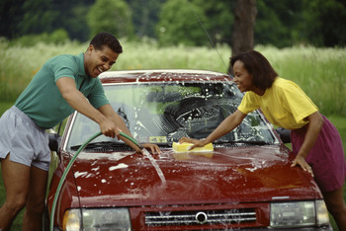
PRESENT CONTINUOUS: QUESTIONS
SHORT ANSWER
LONG ANSWER
QUESTION
Q-WORD + BE + SUBJECT + -ING
(c) Where are they studying?
(d) What are they washing?
(e) Why are they washing the car?
The car.
They are washing the car.
In the classroom.
They are studying
in the classroom.
Because it’s dirty.
They are washing the car because it’s dirty.

Slide 27
SIMPLE PRESENT TENSE vs. PRESENT continuous
STATEMENTS
He eats pancakes every morning.
(b) He is eating pancakes right now.
(c) David rides every day.
(d) David is riding right now.
simple present
habits
usual activities
present continmuous
actions - now

Slide 28
SIMPLE PRESENT TENSE vs. PRESENT continuous
QUESTIONS
(e) Does he eat pancakes every morning?
(f) Is he eating pancakes right now?
(g) Does David ride every day?
(h) Is David riding right now?
simple present do and does as helping verbs
present continuous
am, is, and are
in questions

Slide 29
SIMPLE PRESENT TENSE vs. PRESENT continuous
NEGATIVES
(i) I don’t ride my horse every day.
(j) I’m not riding my horse right now.
(k) She doesn’t exercise every day.
(l) She isn’t exercising right now.
simple present
uses do and does
as helping verbs
present continuous
uses am, is, and are
in negatives

Slide 30
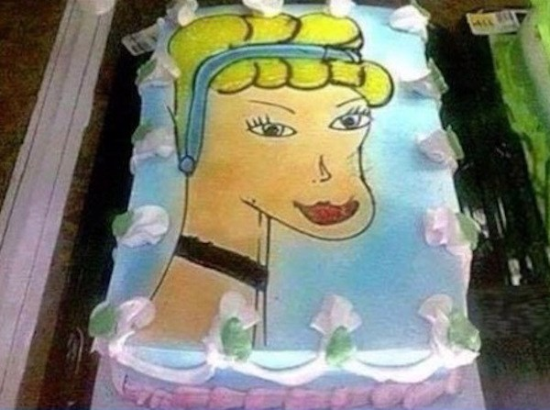
STATE VERBS NOT USED IN THE PRESENT CONTINUOUS
I’m hungry right now.
I want some cake.

Slide 31
STATE VERBS NOT USED IN THE PRESENT CONTINUOUS
(a) I’m thirsty right now.
I want some water.
not used
in present
continuous
?
I am wanting some water.
Nonaction verbs
want
physical or emotional need

Slide 32
STATE VERBS NOT USED IN THE PRESENT CONTINUOUS
SOME COMMON STATE VERBS
dislike
hate
like
love
need
want

Slide 33
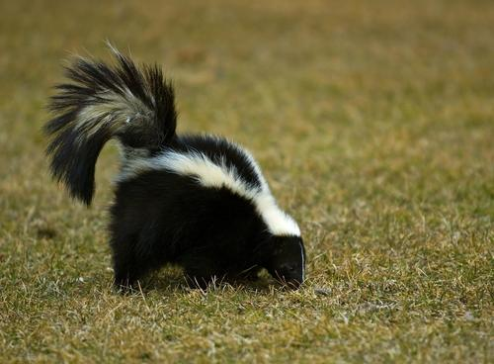
STATE VERBS NOT USED IN THE PRESENT CONTINUOUS
State verbs
(b) I smell a skunk.
Do you smell it too?
smell
sensory experience
?
Are you smelling it too?
NOT used in
present continuous

Slide 34
STATE VERBS NOT USED IN THE PRESENT CONTINUOUS
OTHER COMMON STATE VERBS
hear
see
smell
taste
believe
know
think (believe)
understand

