Slide 1
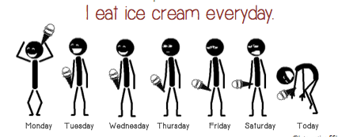
PRESENT SIMPLE

Slide 2
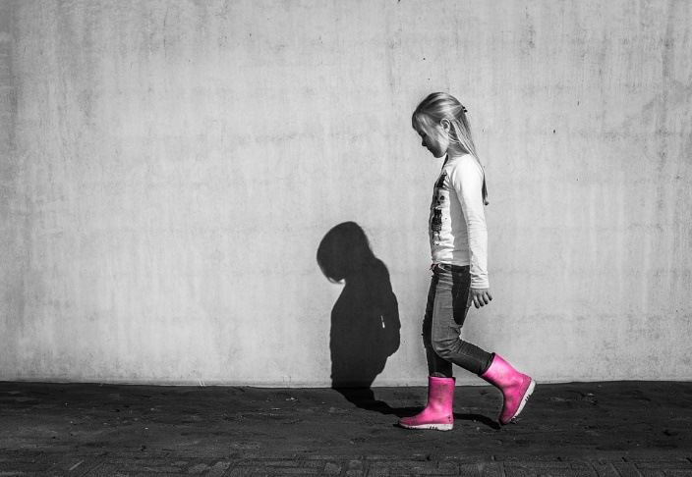
FORM AND BASIC MEANING OF THE SIMPLE PRESENT TENSE
She walks.

Slide 3
FORM AND BASIC MEANING OF THE SIMPLE PRESENT TENSE
SINGULAR PLURAL
1st PERSON
I walk
we walk
2nd PERSON
you walk
you walk
3rd PERSON
she walks
he walks
it walks
they walk

Slide 4
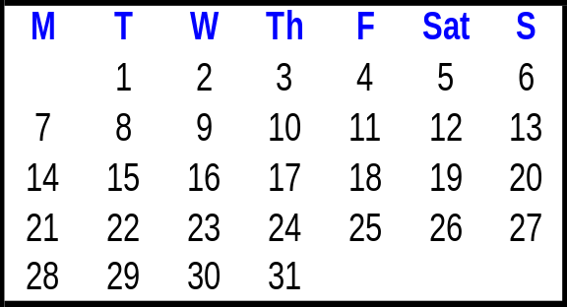
FORM AND BASIC MEANING OF THE SIMPLE PRESENT TENSE
(a) I eat lunch every afternoon.
(b) Max drives to work every day.
(c) We get up every morning.
(d) Kyle calls Mimi every weekend.
Monday
Tuesday
Wednesday
Thursday
Friday
Saturday
Sunday
HABITS = USUAL ACTIVITIES

Slide 5
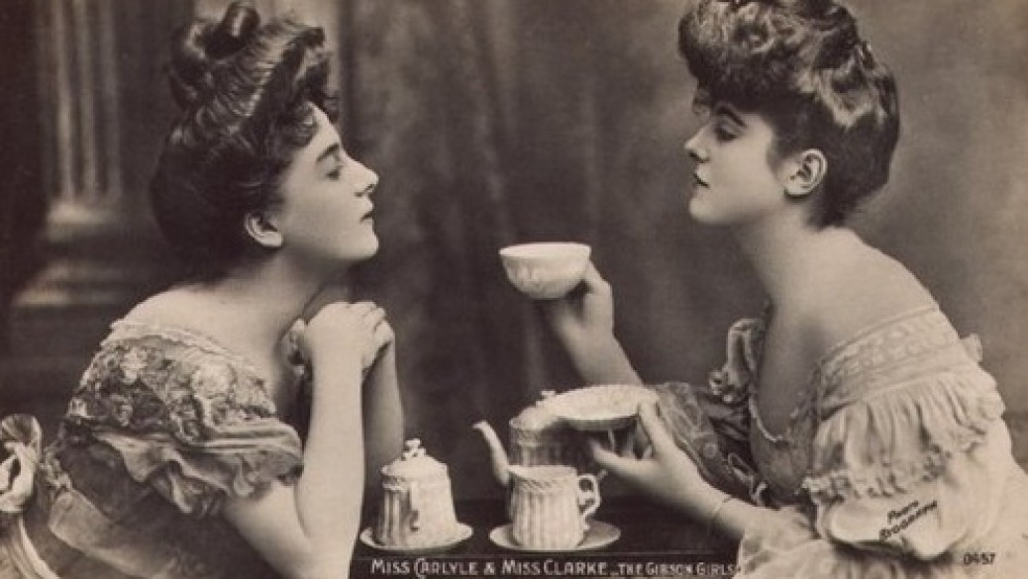
FREQUENCY ADVERBS
They always drink tea with lunch.

Slide 6
FREQUENCY ADVERBS
100%
(a) Mary always eats lunch at school.
90%- 99%
(b) Mary usually eats lunch at school.
75%- 90%
(c) Josh often eats hamburgers.
25%- 75%
(d) Tia sometimes eats lunch at school.
5%- 10%
(e) Tia seldom eats lunch at school.
1%- 10%
(f) Eva rarely washes her car.
0%
(g) Jay never goes to the zoo.
frequency adverbs

Slide 7
Let’s Practice
always
usually
often
sometimes
seldom
rarely
never
Talia _______ feeds her dog.
always
Sun.
Mon.
Tues.
Wed.
Thurs.
Fri.
Sat.
√
√
√
√
√
√
√

Slide 8
Let’s Practice
Jara ______ watches TV.
always
usually
often
sometimes
seldom
rarely
never
seldom
Sun.
Mon.
Tues.
Wed.
Thurs.
Fri.
Sat.
√

Slide 9
Let’s Practice
always
usually
often
sometimes
seldom
rarely
never
Luke _______ cooks dinner.
usually
Sun.
Mon.
Tues.
Wed.
Thurs.
Fri.
Sat.
√
√
√
√
√
√

Slide 10
Let’s Practice
Moussad _________ cooks
dinner.
always
usually
often
sometimes
seldom
rarely
never
sometimes
Sun.
Mon.
Tues.
Wed.
Thurs.
Fri.
Sat.
√
√
√
√

Slide 11
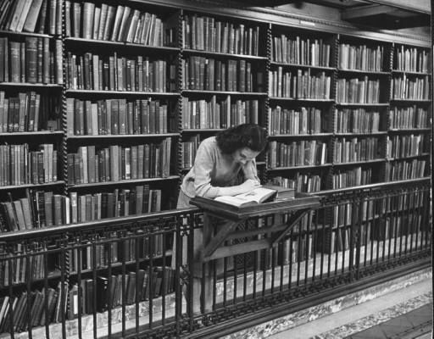
OTHER FREQUENCY EXPRESSIONS
She goes to
the library
once a week.

Slide 12
OTHER FREQUENCY EXPRESSIONS
once a week.
twice a week.
five times a week.
(a) She goes to the library
Sun.
Mon.
Tues.
Wed.
Thurs.
Fri.
Sat.
√
√
√
√
√
√

Slide 13
OTHER FREQUENCY EXPRESSIONS
(b) I go to school five times a week.
(c) I go to the movies twice a month.
(d) I go to the beach once a year.
how many times
a day a week
a month a year

Slide 14
OTHER FREQUENCY EXPRESSIONS
(e) I feed my dog every morning.
I ride my horse every week.
Every
is
singular.
I wash my car every year.
Correct?
no
every weeks

Slide 15
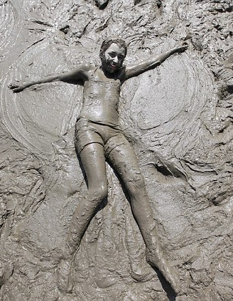
POSITION OF FREQUENCY ADVERBS
Jeff is
always dirty.

Slide 16
POSITION OF FREQUENCY ADVERBS
SUBJECT + BE + FREQUENCY
ADVERB
Jeff + is +
seldom
usually
never
often
rarely
dirty.
always
sometimes
am
is +
are
FREQUENCY ADVERB

Slide 17
POSITION OF FREQUENCY ADVERBS
SUBJECT + FREQUENCY + OTHER SIMPLE
ADVERB PRESENT VERBS
+
seldom
Sergio
sometimes
usually
rarely
never
often
+ rides a bike.
always
all simple
present
verbs
except be
frequency adverb +

Slide 18
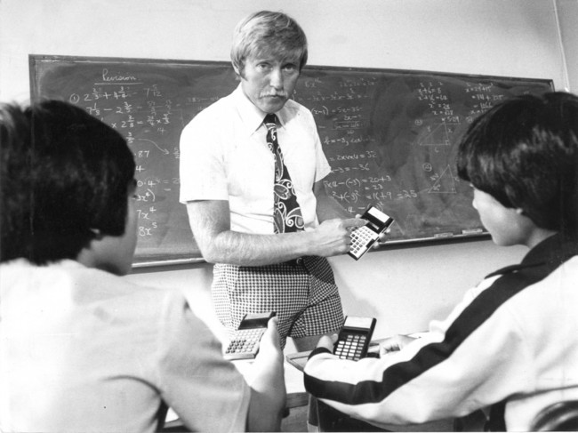
SPELLING AND PRONUNCIATION OF FINAL -ES
Gerardo teaches math.

Slide 19
SPELLING AND PRONUNCIATION OF FINAL -ES
SPELLING
PRONUNCIATION
-sh
(a) push
pushes
push /əz/
-ch
(b) teach
teaches
teach /əz/
-ss
(c) kiss
kisses
ə
kiss / z/
-x
(d) fix
fixes
ə
fix / z/
endings
add -es
say
/əz/

Slide 20
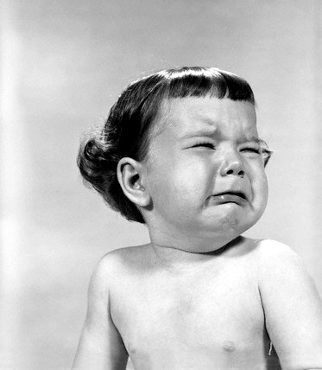
ADDING FINAL -S -ES TO WORDS THAT END IN -Y
The baby cries a lot.

Slide 21
ADDING FINAL -S -ES TO WORDS THAT END IN -Y
(a) cry
cries
consonant + -y
change y to i,
add -es
fly
flies
(b) pay
pays
vowel + -y
add -s
enjoy
enjoys

Slide 22
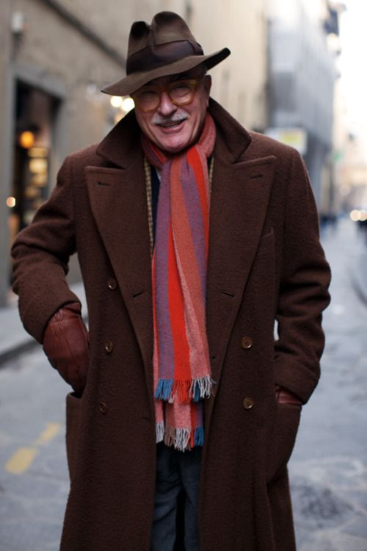
IRREGULAR SINGULAR VERBS: HAS, DOES, GOES
The man has a brown coat.

Slide 23
IRREGULAR SINGULAR VERBS: HAS, DOES, GOES
Irregular forms:
she
he
it
(a) I have a hat.
+
has
(b) She has a hat.
have
has
she
he
it
(c) I do exercises.
(d) He does exercises.
does
+
do
does
she
he
it
(e) We go to the gym.
(f) He goes to the gym.
goes
+
go
goes

Slide 24
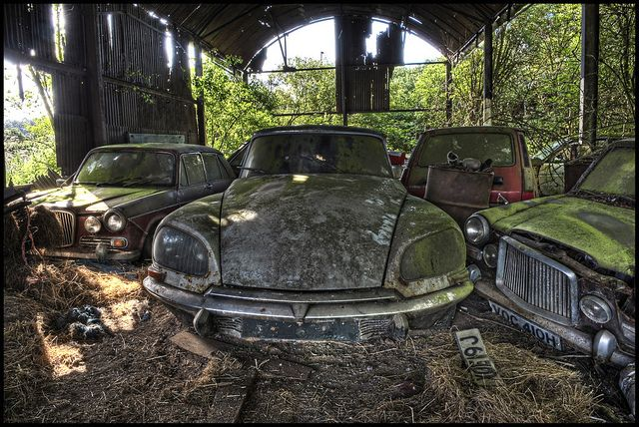
SIMPLE PRESENT TENSE: NEGATIVE
They do not wash their car.

Slide 25
SIMPLE PRESENT TENSE: NEGATIVE
They
We
You
I
(a) do not drink milk.
I
We
You
They
NEGATIVE:
+ do not + main verb
He
She
It
(b) does not drink milk.
She
He
It
+ does not + main verb

Slide 26
SIMPLE PRESENT TENSE: NEGATIVE
I do not drink milk.
She does not drink milk.
do and does = helping verbs
?
She does not drinks milk.
3rd person singular no -s on main verb

Slide 27
SIMPLE PRESENT TENSE: NEGATIVE
(c) I don’t drink milk.
They don’t go to the lake.
(d) He doesn’t drink milk.
Jack doesn’t like dogs.
CONTRACTIONS:
do not = don’t
does not = doesn’t

Slide 28
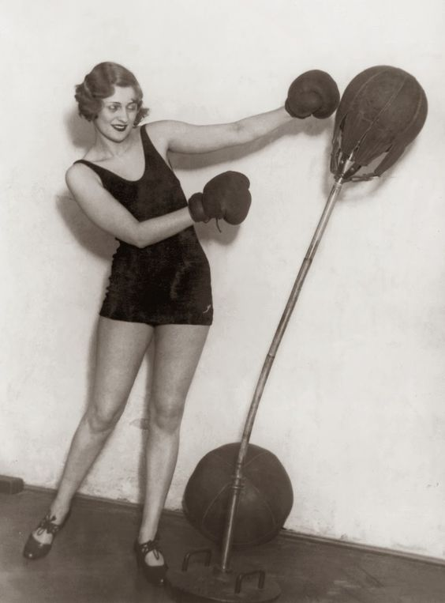
SIMPLE PRESENT TENSE: YES -NO QUESTIONS
Does she exercise?

Slide 29
SIMPLE PRESENT TENSE: YES -NO QUESTIONS
DO/ + SUBJECT + MAIN
DOES VERB
(b) Do you like salad?
(c) Do we like salad?
(d) Do they like salad?
(a) Do I like salad?
QUESTION FORMS, SIMPLE PRESENT
Do you + main verb
(simple form)
Do we + main verb
(simple form)
Do they + main verb
(simple form)
Do I + main verb
(simple form)

Slide 30
SIMPLE PRESENT TENSE: YES -NO QUESTIONS
DO/ + SUBJECT + MAIN
DOES VERB
(g) Does it look good?
(e) Does she like salad?
(f) Does he like salad?
QUESTION FORMS, SIMPLE PRESENT
Does she + main verb
(simple form)
Does it + main verb
(simple form)
Does he + main verb
(simple form)

Slide 31
SIMPLE PRESENT TENSE: YES -NO QUESTIONS
(h) Are you a student?
NOT: Do you be a student?
main verb = a form of be
do

Slide 32
SIMPLE PRESENT TENSE: YES -NO QUESTIONS
QUESTION SHORT ANSWER
(i) Do you like ice cream?
Yes, I do.
No, I don’t.
(j) Does Max like ice cream?
Yes, he does.
No, he doesn’t.

Slide 33
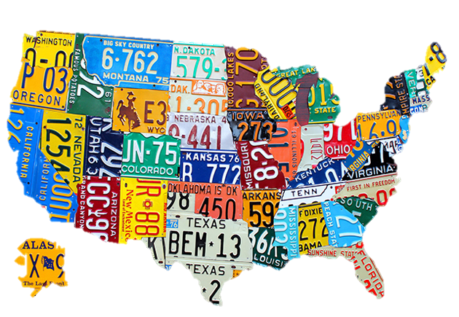
SIMPLE PRESENT TENSE: ASKING INFORMATION
QUESTIONS WITH WHERE AND WHAT
Where do they live?
Do they live in Baltimore?
What do they study?
Do they study English?
*

Slide 34
SIMPLE PRESENT TENSE: ASKING INFORMATION
QUESTIONS WITH WHERE AND WHAT
QUESTION SHORT ANSWER
(a) Do they live in Baltimore?
Yes, they do.
No, they don’t.
(b) Where do they live?
In Baltimore.

Slide 35
SIMPLE PRESENT TENSE: ASKING INFORMATION
QUESTIONS WITH WHERE AND WHAT
QUESTION SHORT ANSWER
(a) Do they study English?
Yes, they do.
No, they don’t.
(b) What do they study?
English.

Slide 36
SIMPLE PRESENT TENSE: ASKING INFORMATION
QUESTIONS WITH WHERE AND WHAT
QUESTION SHORT ANSWER
(a) Does Allison teach math?
Yes, she does.
No, she doesn’t.
(b) What does she teach?
Math.

Slide 37
SIMPLE PRESENT TENSE: ASKING INFORMATION
QUESTIONS WITH WHERE AND WHAT
+
+
+
(WHERE)
DO/DOES
SUBJECT
MAIN VERB
(a) in Baltimore
Do
they
live
?
(b) Where
do
they
live
?
(c) in Moscow
Does
Alexi
live
?
(d) Where
does
he
live
?

Slide 38
SIMPLE PRESENT TENSE: ASKING INFORMATION
QUESTIONS WITH WHERE AND WHAT
(WHAT)
+
DO/DOES
+
SUBJECT
+
MAIN VERB
(a) English?
Do
they
study
(b) What
do
they
study
?
Does
Allison
teach
(c) math?
(d) What
?
does
she
teach

Slide 39
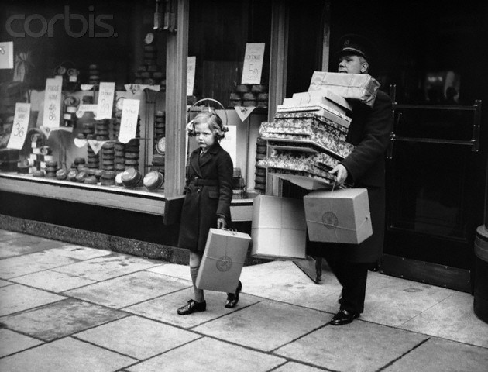
SIMPLE PRESENT TENSE: ASKING INFORMATION
QUESTIONS WITH WHEN AND WHAT TIME
When do you go shopping?
What time do you go shopping?

Slide 40
SIMPLE PRESENT TENSE: ASKING INFORMATION
QUESTIONS WITH WHEN AND WHAT TIME
Q-WORD + DO/ + SUBJECT + MAIN
DOES VERB
(a) When do you go to work?
At eight o’clock.
(b) What time do you go to work?
At eight o’clock.

Slide 41
SIMPLE PRESENT TENSE: ASKING INFORMATION
QUESTIONS WITH WHEN AND WHAT TIME
Q-WORD + DO/ + SUBJECT + MAIN
DOES VERB
(c) When does he exercise?
At ten o’clock.
(d) What time does he exercise?
At ten o’clock.

Slide 42
SIMPLE PRESENT TENSE: ASKING INFORMATION
QUESTIONS WITH WHEN AND WHAT TIME
Q-WORD + DO/ + SUBJECT + MAIN VERB
DOES
(e) What time do you usually go to class?
frequency
adverb
main
verb
subject
+
+

